Slide 1

DESIGN OF FREQUENCY SELECTIVE SURFACE
Hareesh Aravind.R.G
124004092
Rakhul.M
124004168
SEEE-ECE
Supervisor Name : Dr.Yogeshwari.P
AP-Research
SEEE-ECE
SASTRA DEEMED UNIVERSITY

Slide 2

PRESENTATION OUTLINE
Background and Problem Statement
Objective of the work
Unit cell
Equivalent Circuit
Frequency selective surface
Antenna
FSS on top of antenna
Literature Survey
Time line activity
Reference

Slide 3
BACKGROUND AND PROBLEM STATEMENT
5G offers higher data rates, lower latency, and improved network reliability using higher frequency bands.
Higher frequencies result in shorter wavelengths and reduced signal propagation distances, increasing susceptibility to obstacles.
More base stations are required in 5G to ensure coverage, leading to higher costs and complex network management.
FSS can filter specific frequency bands, enhancing signal propagation and antenna performance, addressing 5G deployment challenges.
Reduced signal propagation at higher frequencies necessitates more base stations, raising costs and complexity.
Design an FSS to improve antenna performance and reduce the need for additional base stations in 5G networks.

Slide 4
OBJECTIVE OF THE WORK
Develop and optimize a unit cell structure for 5G frequencies, including the extraction of an equivalent circuit model to characterize its behavior.
Arrange the unit cells into a periodic frequency selective surface (FSS) array optimized for desired frequency response characteristics.
Design an antenna suitable for 5G applications and integrate the FSS to enhance the antenna's gain and directivity.
To provide a cost-effective solution for enhanced 5G network performance.

Slide 5

UNIT CELL
UNIT CELL - DESIGN

Slide 6
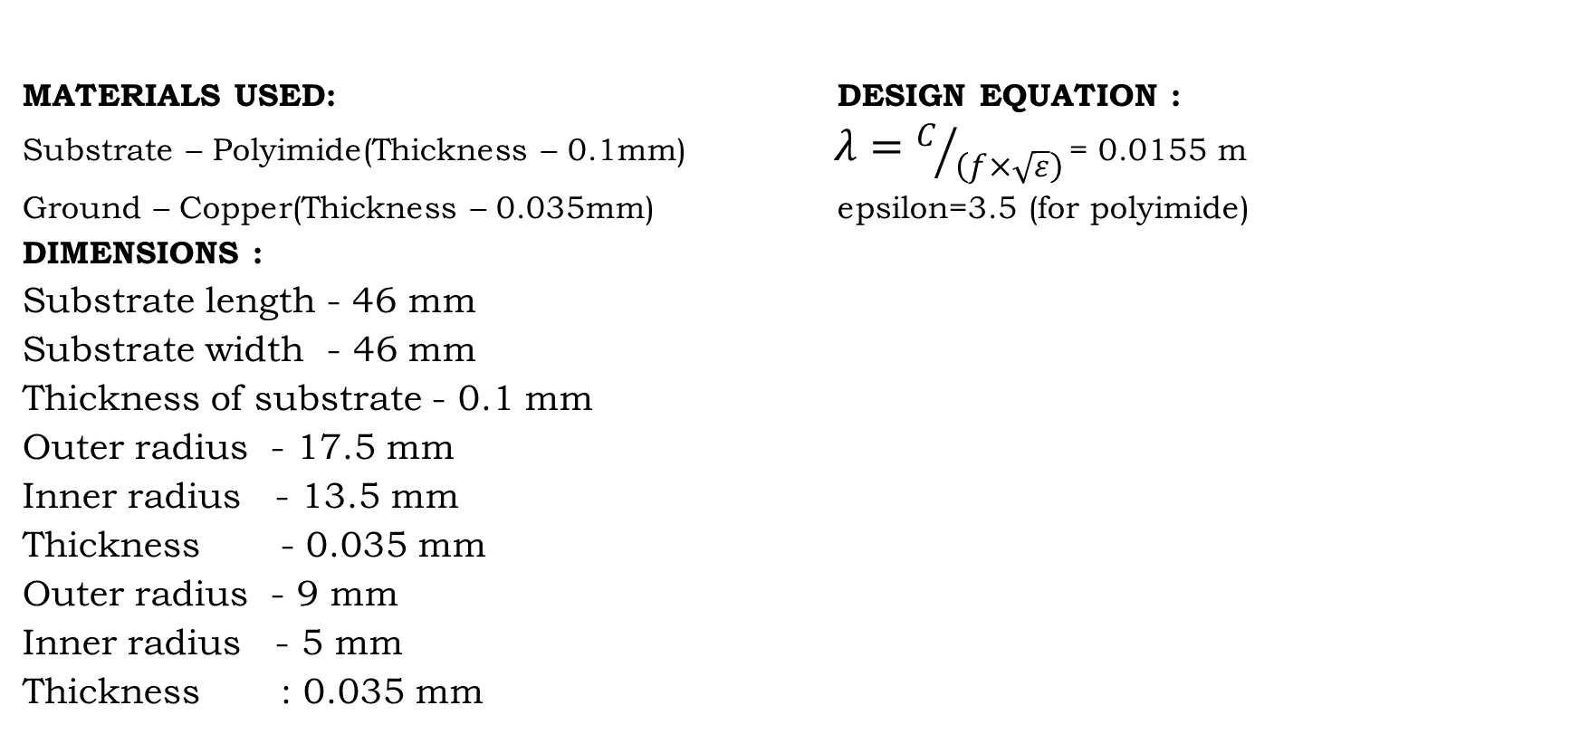
DESIGN
MATERIALS USED: DESIGN EQUATION :
Substrate – Polyimide(Thickness – 0.1mm) $λ=C/{\left(f×\sqrt{ε}\right)}$= 0.0155 m
Ground – Copper(Thickness – 0.035mm) epsilon=3.5 (for polyimide)
DIMENSIONS :
Substrate length - 46 mm
Substrate width - 46 mm
Thickness of substrate - 0.1 mm
Outer radius - 17.5 mm
Inner radius - 13.5 mm
Thickness - 0.035 mm
Outer radius - 9 mm
Inner radius - 5 mm
Thickness : 0.035 mm

Slide 7
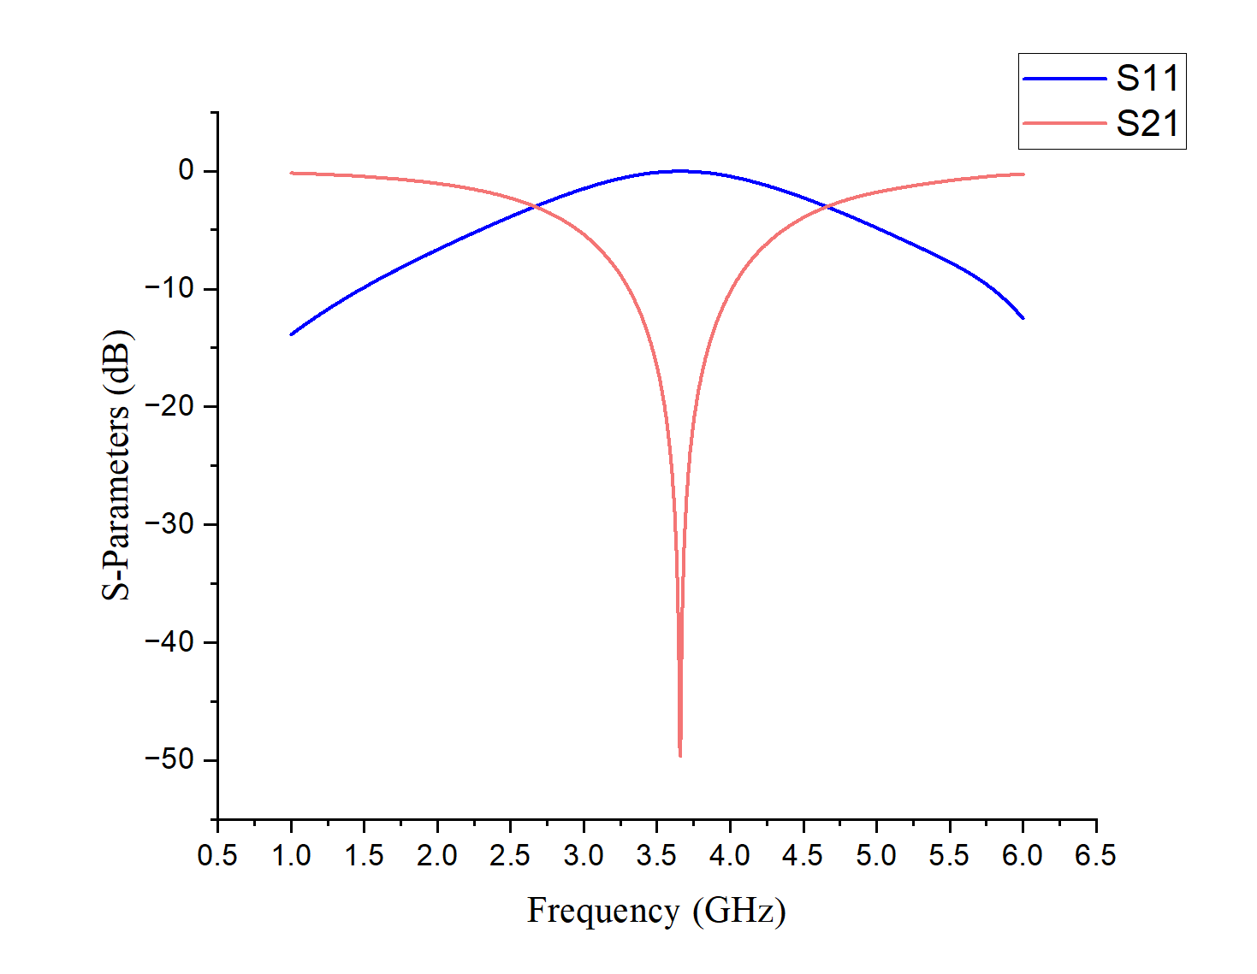
OUTPUT S PARAMETERS – UNIT CELL

Slide 8
OBSERVATIONS
S11 – Reflection Coefficient
In our case it is almost 100 percent reflective
S21 – Transmission Coefficient
Denotes how much incident power is transmitted in the other side of the unit cell. The value here is negative which means that very less power has been transmitted from one side to another side.
This implies that the unit cell designed is reflective in nature

Slide 9
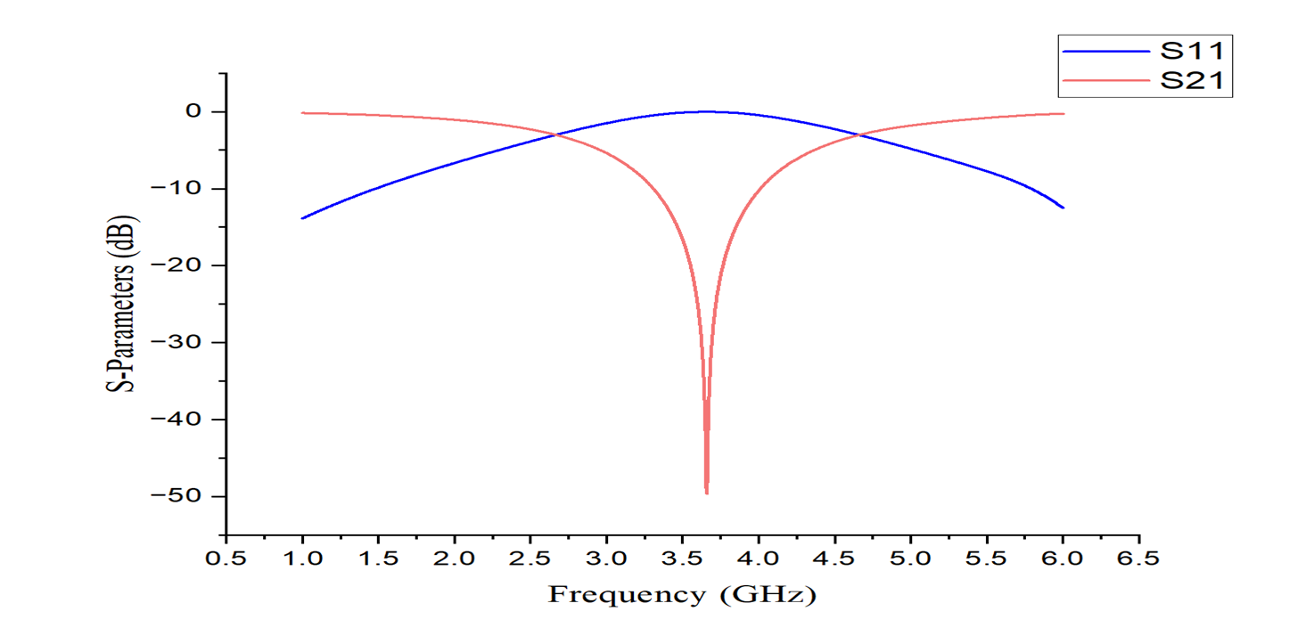
OUTPUT – S PARAMETERS FOR DIFFERENT POLARIZATION ANGLES
Angle (in degrees) | Output
0
15

Slide 10
OUTPUT – S PARAMETERS FOR DIFFERENT POLARIZATION ANGLES
Angle (in degrees) | Output
30
45

Slide 11
OUTPUT – S PARAMETERS FOR DIFFERENT POLARIZATION ANGLES
Angle (in degrees) | Output
60

Slide 12
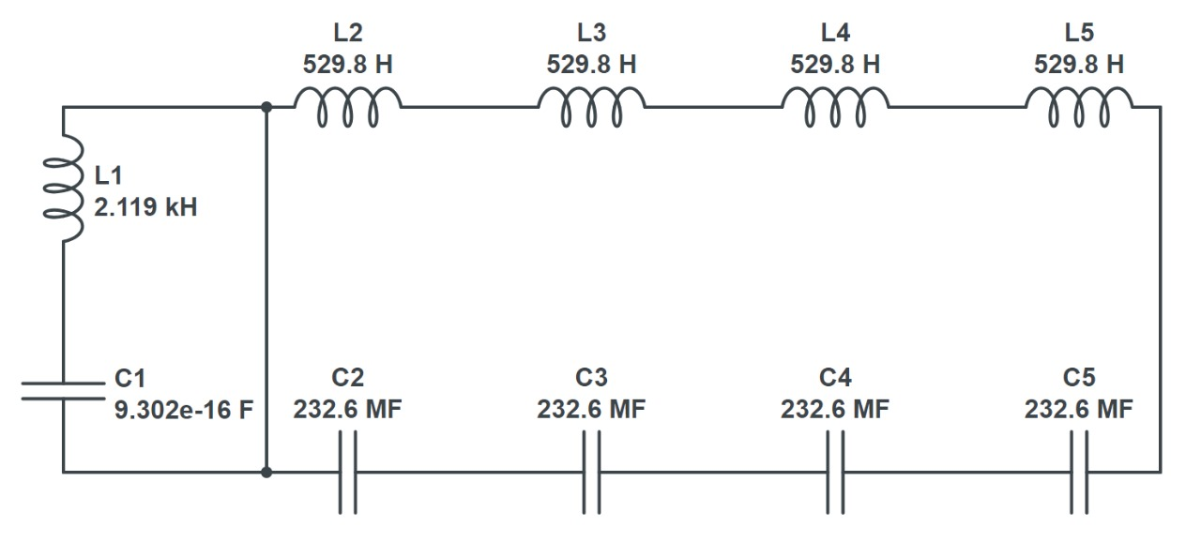
EQUIVALENT CIRCUIT

Slide 13
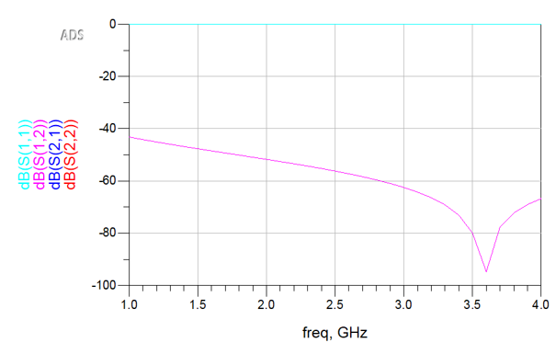
S-PARAMETERS OF EQUIVALENT CIRCUIT

Slide 14
OBSERVATION
At 3.6 GHz, S-parameter analysis indicates significant transmission or reflection, showcasing the unit cell's frequency selectivity here it is highly reflectory in 3.6 GHz.
This behavior signifies the unit cell's efficacy in managing specific frequency bands, crucial for optimizing 5G signal propagation.
Understanding S-parameter characteristics at this frequency aids in refining the unit cell design for enhanced performance.
Further optimization based on these observations can lead to improved spectrum utilization and overall 5G network efficiency.

Slide 15

FREQUENCY SELECTIVE SURAFCE
FREQUENCY SELECTIVE SURAFCE - DESIGN

Slide 16
DESIGN
MATERIALS USED:
SUBSTRATE – Polyimide(THICKNESS – 0.1mm)
GROUND – Copper(THICKNESS – 0.035mm)
DIMENSIONS :
Total Substrate length - 184 mm
Total Substrate width - 184 mm
Thickness of substrate - 0.1 mm
Outer radius - 17.5 mm
Inner radius - 13.5 mm
Thickness - 0.035 mm
Outer radius - 9 mm
Inner radius - 5 mm
Thickness : 0.035 mm

Slide 17
OUTPUT S PARAMETERS – FREQUENCY SELECTIVE SURFACE

Slide 18
OBSERVATIONS
S11 – Reflection Coefficient
In our case it is almost 100 percent reflective
S21 – Transmission Coefficient
Denotes how much incident power is transmitted in the other side of the unit cell. The value here is negative which means that very less power has been transmitted from one side to another side.
This implies that the unit cell designed is reflective in nature

Slide 19
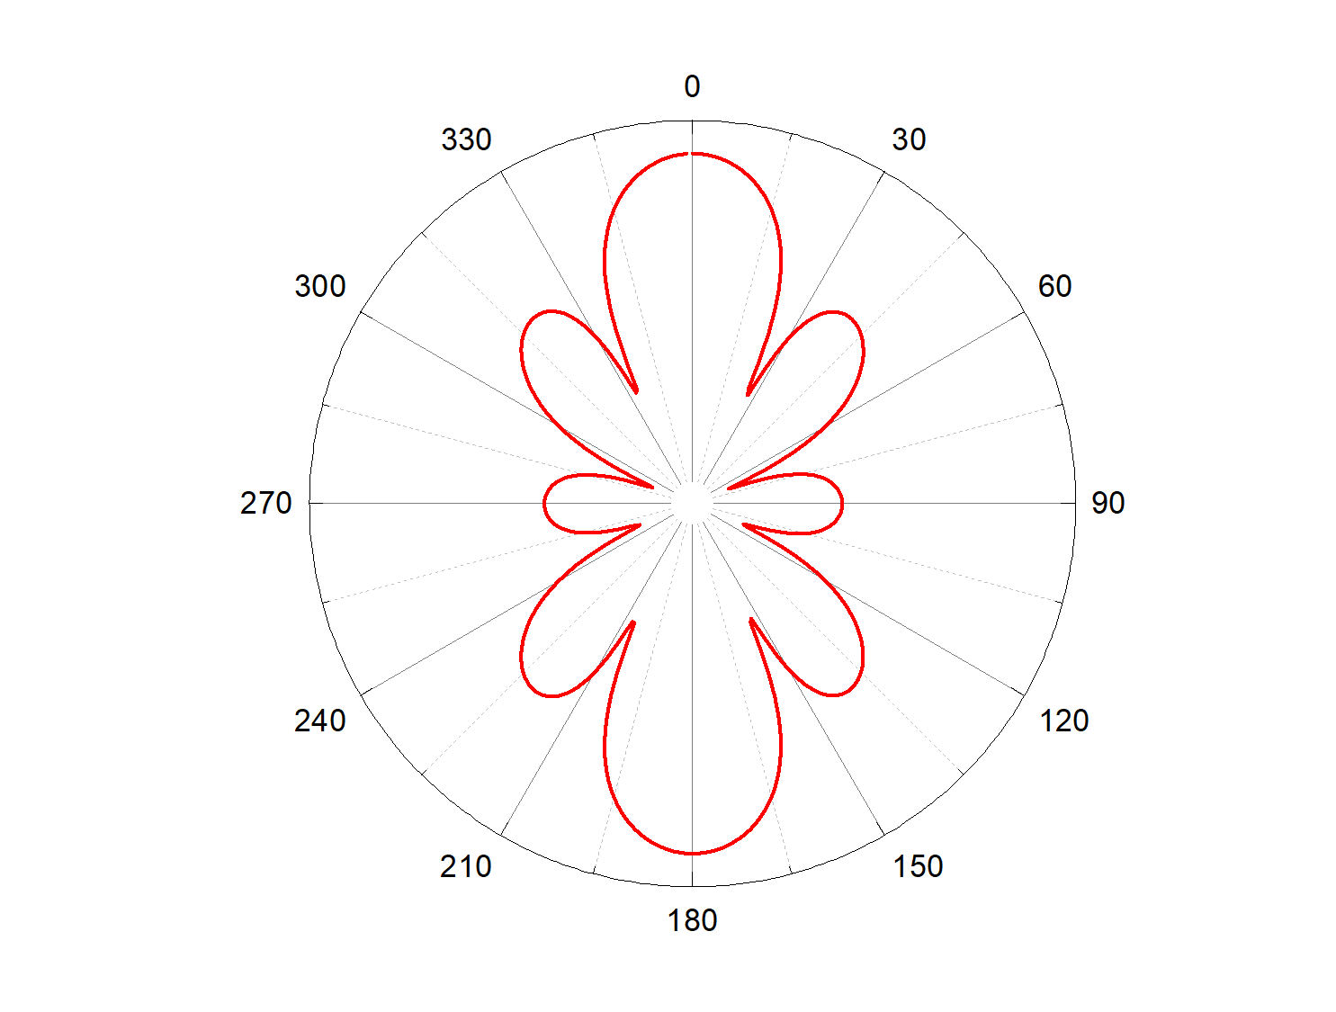
FSS – RADIATION PATTERN

Slide 20
OUTPUT – S PARAMETERS FOR DIFFERENT POLARIZATION ANGLES
Angle (in degrees) | Output
0
15

Slide 21
OUTPUT – S PARAMETERS FOR DIFFERENT POLARIZATION ANGLES
Angle (in degrees) | Output
30
45

Slide 22
OUTPUT – S PARAMETERS FOR DIFFERENT POLARIZATION ANGLES
Angle (in degrees) | Output
60

Slide 23
RESULT
Developed a geometrically optimized structure with consideration of material properties and size for desired frequency response.
Derived a precise circuit model representing unit cell behavior, incorporating inductors and conductors for accurate electrical representation.
Translated unit cell design into a scalable FSS structure, enabling effective frequency filtering and transmission control.
Conducted S-parameter analysis to validate unit cell and FSS performance, providing insights for further optimization and application in 5G networks.

Slide 24
APPLICATIONS
The Flexible Substrate System (FSS) offers versatile applications.
Firstly, it can be integrated into Intelligent Reflecting Surface (IRS) panels by incorporating varactor diodes and components like capacitors.
This enables dynamic control over reflection properties.
Secondly, the FSS can enhance antenna gain, improving signal reception and transmission capabilities
These applications demonstrate the adaptability and potential of FSS technology in diverse fields.

Slide 25

ANTENNA
DESIGN

Slide 26
DESIGN
MATERIALS USED:
SUBSTRATE – Polyimide(THICKNESS – 0.1mm)
GROUND – Copper(THICKNESS – 0.035mm)

Slide 27
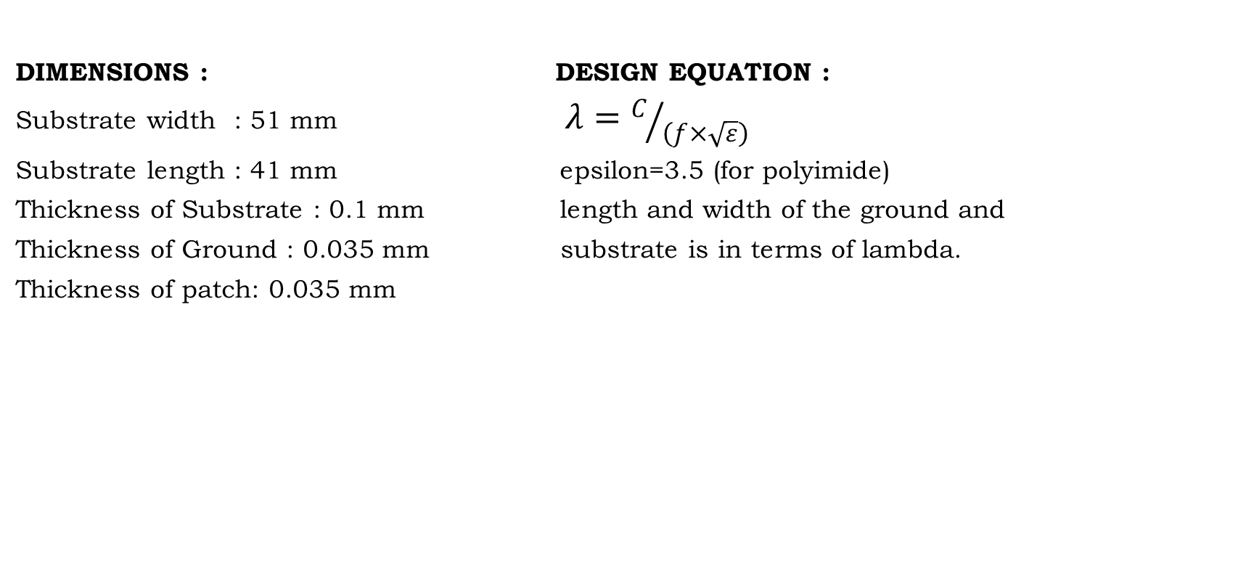
DESIGN
DIMENSIONS : DESIGN EQUATION :
Substrate width : 51 mm $λ=C/{\left(f×\sqrt{ε}\right)}$
Substrate length : 41 mm epsilon=3.5 (for polyimide)
Thickness of Substrate : 0.1 mm length and width of the ground and
Thickness of Ground : 0.035 mm substrate is in terms of lambda.
Thickness of patch: 0.035 mm

Slide 28
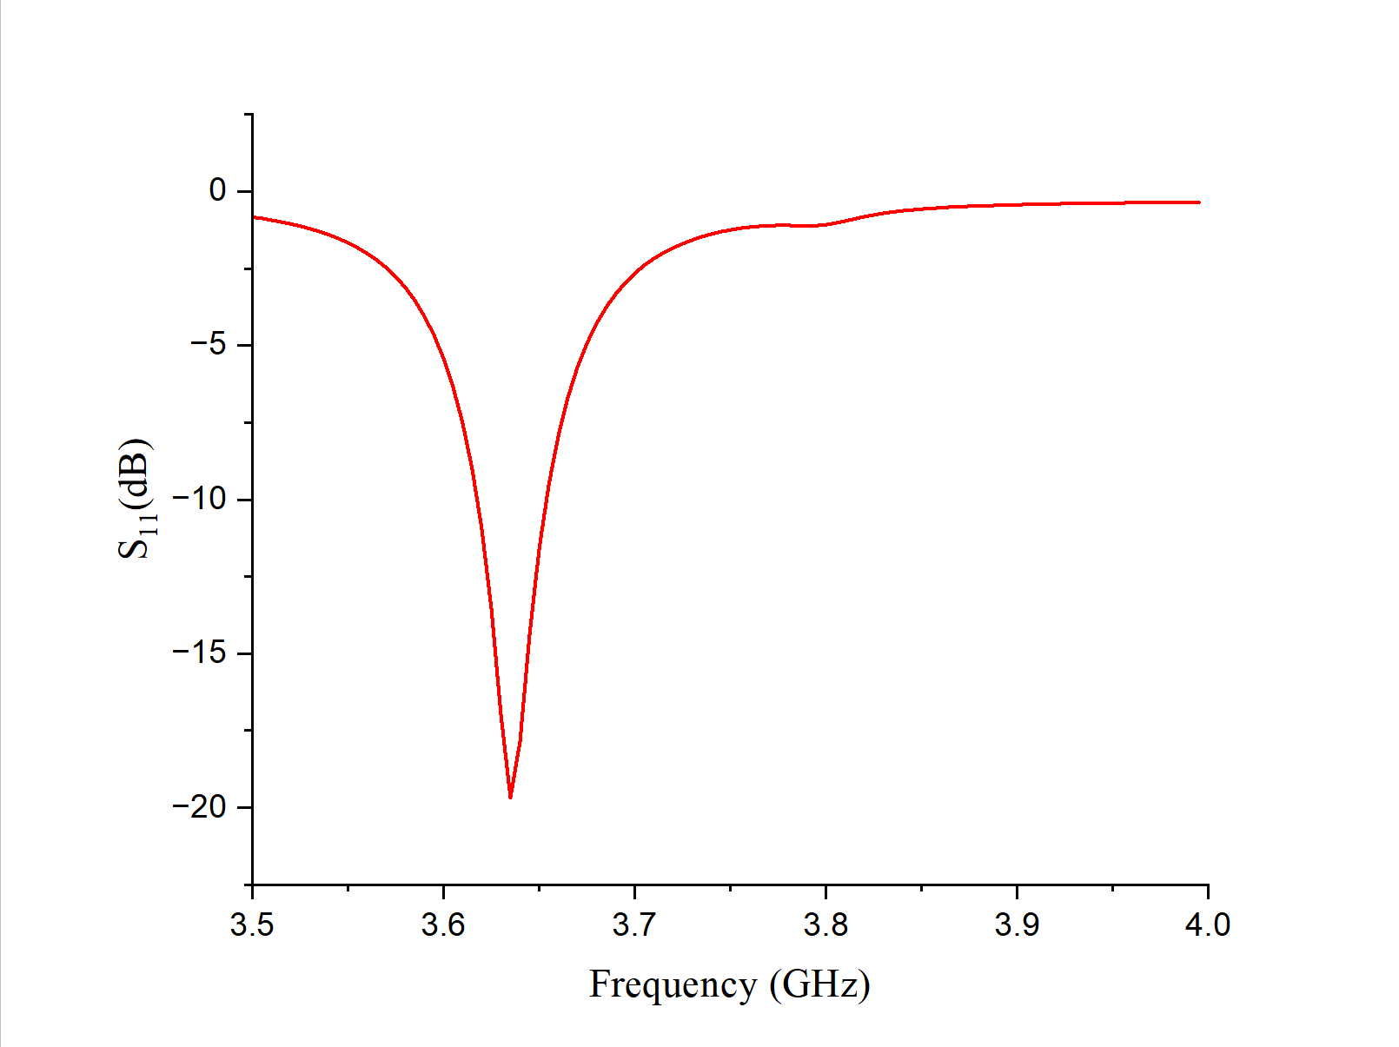
OUTPUT – S PARAMETER

Slide 29
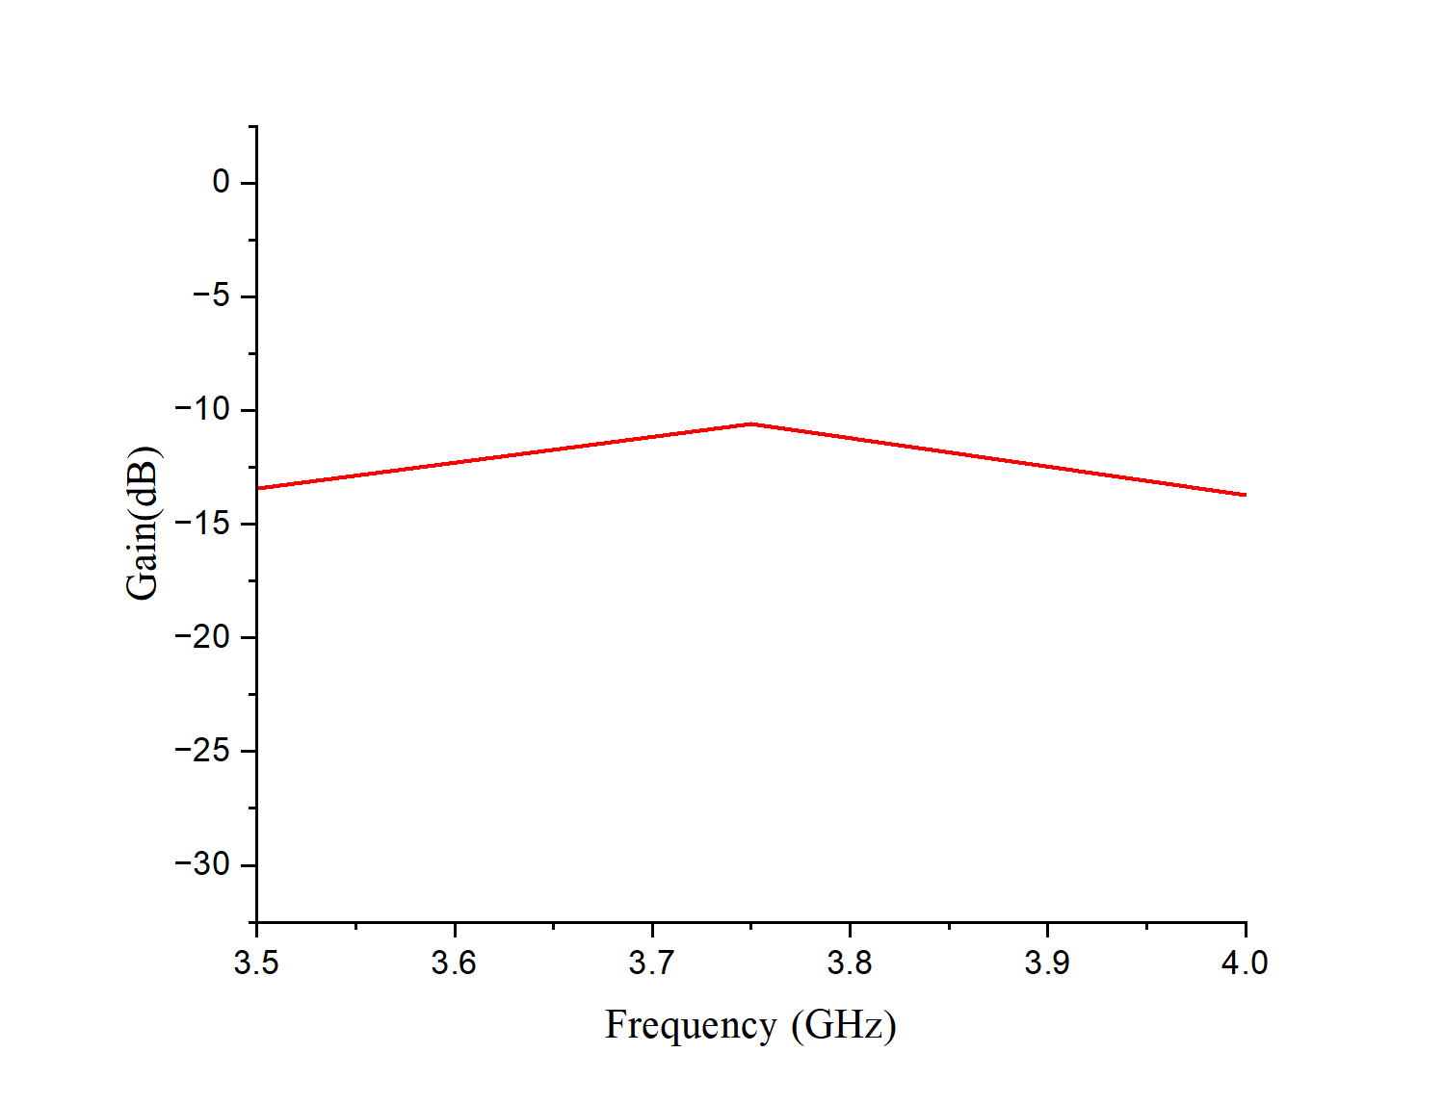
OUTPUT – GAIN

Slide 30
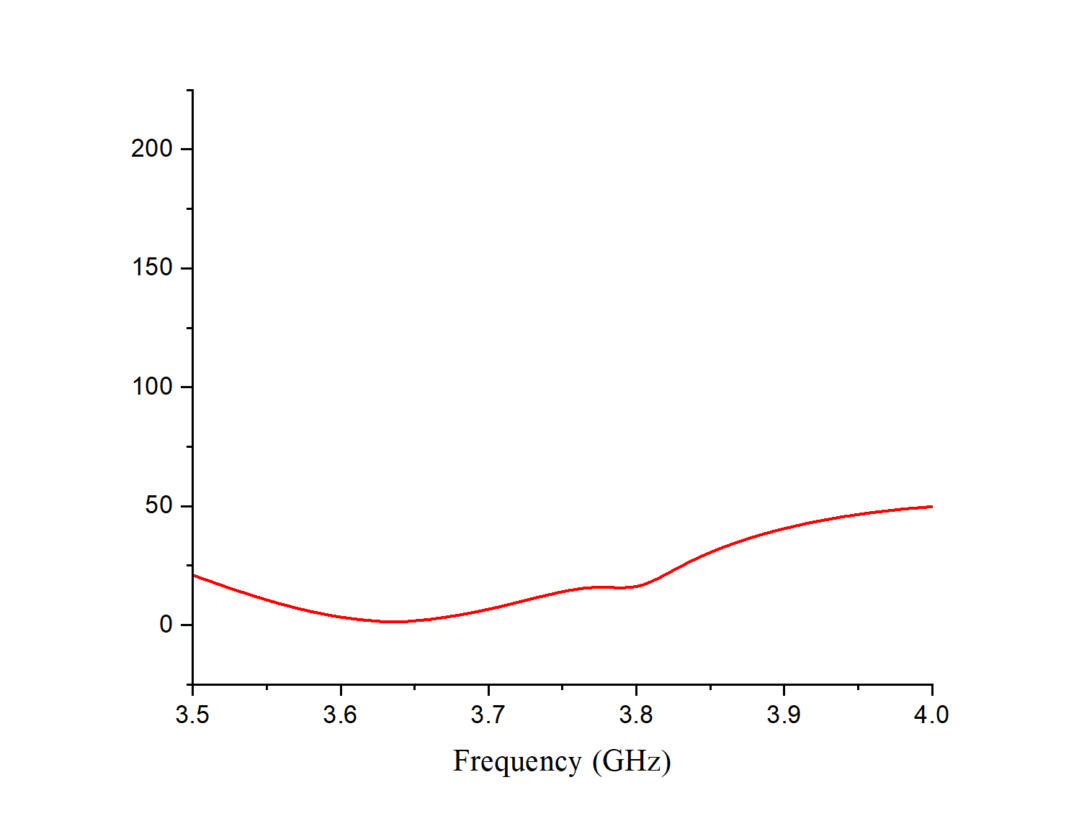
OUTPUT – VSWR

Slide 31
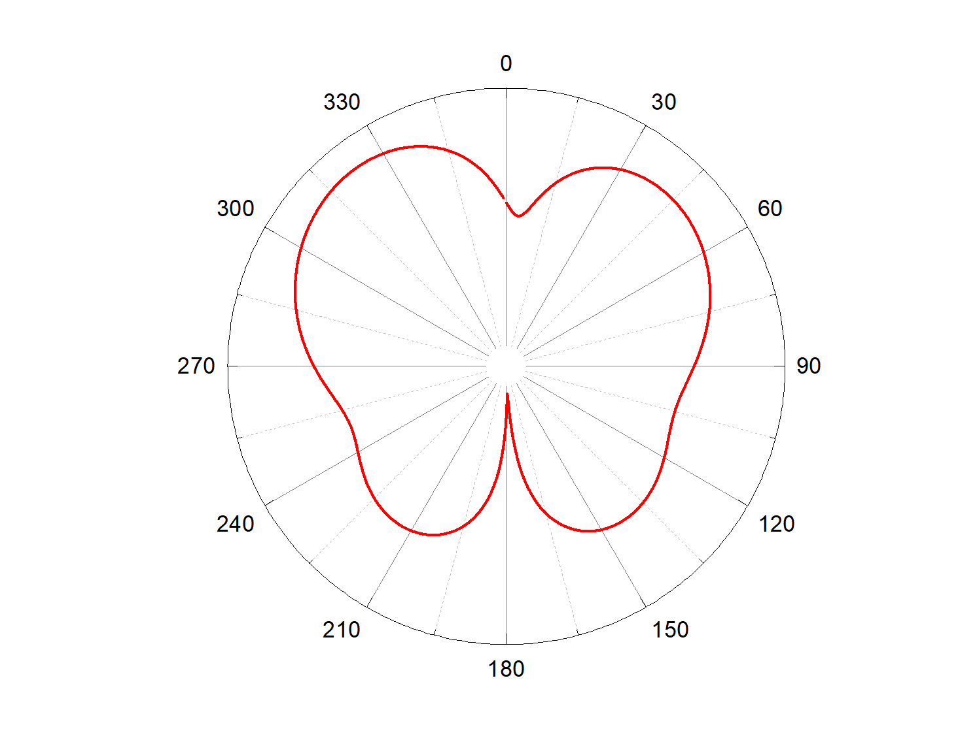
OUTPUT – RADIATION PATTERN

Slide 32
OBSERVATIONS
S11 refers to the reflection coefficient, and a dip in S11 suggests that less power is being reflected back to the source, indicating better impedance matching or resonance at that frequency.
Given that there's a dip in S11 at 3.6 GHz frequency, it implies that the antenna is well matched or resonant at this frequency.
Additionally, a gain of -3.73 dB at 3.6 GHz indicates the antenna's radiation efficiency or its ability to radiate power in that frequency band.

Slide 33
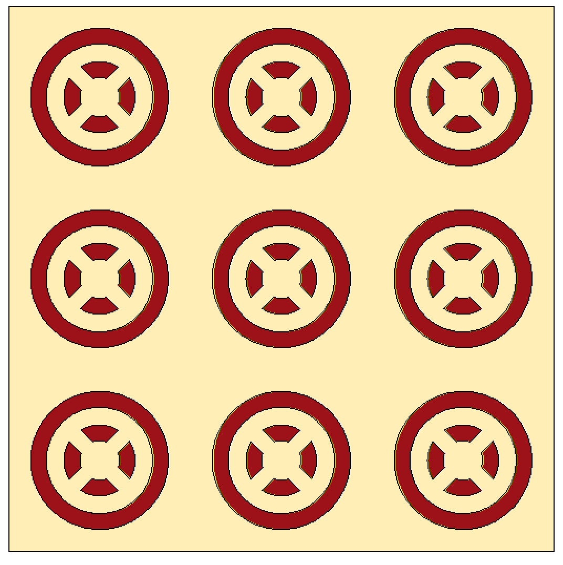

FREQUENCY SELECTIVE SURAFCE MOUNTED ON THE TOP OF ANTENNA
FRONT VIEW BACK VIEW

Slide 34


FREQUENCY SELECTIVE SURAFCE MOUNTED ON THE TOP OF ANTENNA
SIDE VIEW

Slide 35
OUTPUT – S PARAMETERS

Slide 36
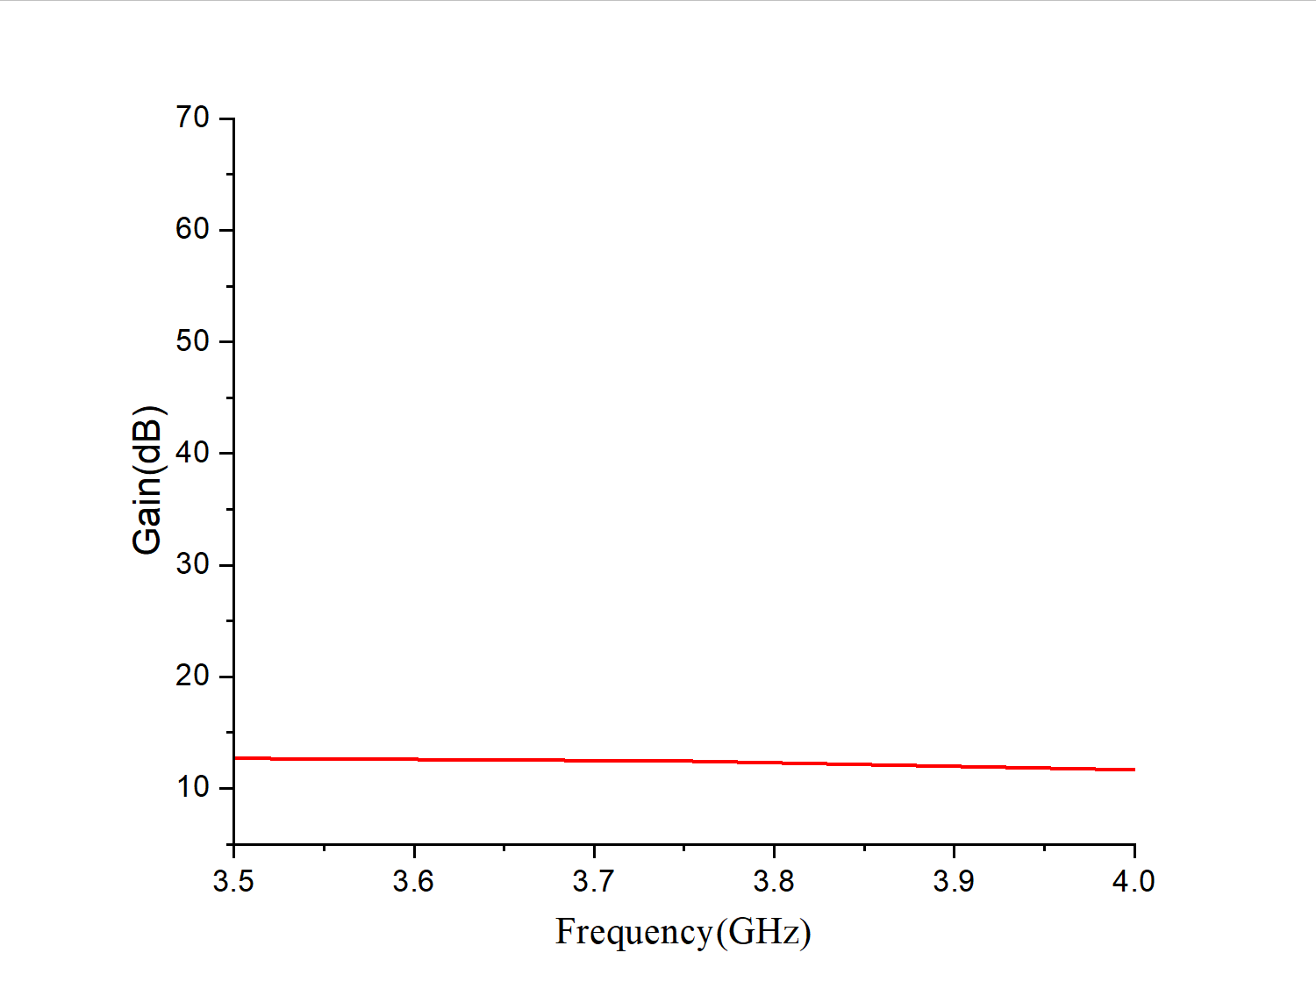
OUTPUT - GAIN

Slide 37
RESULT
The change in gain from -11.78 dB to 12.54 dB by placing an FSS on top of the antenna signifies a significant enhancement in the antenna's performance, likely involving improved directionality, efficiency, and frequency response tailored to specific application requirements.

Slide 38
REASON
Reflective surfaces can redirect waves toward the antenna. This results in Gain Enhancement.
Placing a Frequency Selective Surface (FSS) on top of an antenna can increase its gain by helping to improve its directivity and radiation pattern.
FSS acts as a reflector or director, directing the radiation pattern of the antenna in a desired direction and suppressing radiation in unwanted directions, thus increasing the antenna's gain in the desired direction.
Additionally, FSS can also help in reducing backlobes and sidelobes, further enhancing the antenna's performance.

Slide 39
LITERATURE SURVEY
Paper title | Citations | Observation
Reconfigurable Intelligent Surface (RIS) in the Sub-6 GHz Band: Design, Implementation, and Real-World Demonstration | E. Basar, M. Di Renzo, J. De Rosny, M. Debbah, M. Alouini, and R. Zhang, ‘‘Wireless communications through reconfigurable intelligent surfaces,’’ IEEE Access, vol. 7, pp. 116753–116773, 2019. | Basics of Reconfigurable Intelligence Surface and Designing equivalent circuit.
Reconfigurable Intelligent Surface-Based Wireless Communications: Antenna Design, Prototyping, and Experimental Results | M. Ruchitha, Sara Suzain, Rajalekshmi Kishore, Sanjeev Gurugopinath, "Real-Time Implementation and Analysis of Age of Information for Cognitive Radio Internet-of-Things", 2022 IEEE International Conference on Electronics, Computing and Communication Technologies (CONECCT), pp.1-6, 2022. | Real Time Applications of Reconfigurable Intelligent Surface.

Slide 40
TIMELINE
REVIEW | PLAN
8th Jan – 24th Jan | Identification of problem statement and being familiar with necessary concepts.
25th Jan – 23th Feb | Designing of unit cell, Frequency Selective Surface.
23rd Feb – 1st Apr | Designing an antenna and Extraction of equivalent circuit and analysing the characteristics.
1st Apr – 10th Apr | Report writing

Slide 41
REFERENCE
N. Hussain, M.-J. Jeong, A. Abbas, and N. Kim, “Metasurfacebased single-layer wideband circularly polarized mimo antenna for 5g millimeter-wave systems,” IEEE Access, vol. 8, pp. 130 293–130 304, 2022.
Z. Wang, C. Li, and Y. Yin, “A meta-surface antenna array decoupling (maad) design to improve the isolation performance in a mimo system,” IEEE Access, vol. 8, pp. 61 797–61 805, 2022.
M. D. Renzo, M. Debbah, D.-T. Phan-Huy, A. Zappone, M.-S. Alouini, C. Yuen, V. Sciancalepore, G. C. Alexandropoulos, J. Hoydis, H. Gacanin, J. D. Rosny, A. Bounceur, G. Lerosey, and M. Fink, ‘‘Smart radio environments empowered by reconfigurable AI meta-surfaces: An idea whose time has come,’’ EURASIP J. Wireless Commun. Netw., vol. 2019, no. 1, pp. 1–20, May 2020.

Slide 42
REFERENCE
E. Basar, M. Di Renzo, J. De Rosny, M. Debbah, M.-S. Alouini, and R. Zhang, ‘‘Wireless communications through reconfigurable intelligent surfaces,’’ IEEE Access, vol. 7, pp. 116753–116773, 2020.
X. Gao, L. Dai, and A. M. Sayeed, ‘‘Low RF-complexity technologies to enable millimeter-wave MIMO with large antenna array for 5G wireless communications,’’ IEEE Commun. Mag., vol. 56, no. 4, pp. 211–217, Apr. 2019.

